Slide 1
CSE7302 - INTERNSHIP Review-5 Presentation TITLE OF THE INTERNSHIP / WORK ASSIGNED / DOMAIN
Student Details
Name | HARSHITH V
Roll No | 20221CSE0635
Section | 8CSE12
Under the Supervision of,
Mr. H Senthil Kumar
Associate Professor
Presidency School of CSE
Presidency University
Name of the Program: B-Tech CSE
Name of the HoD: Dr. Asif Mohammed
Name of the Program Internship Coordinator: Mr. Sakthi S
Name of the School Internship Coordinator: Dr. Md Ziaur Rahman

Slide 2
Content
About Company or Organization
Working domain or the technology
About your team and reporting Manager
Challenges Faced in Internship
Objectives of the work
Literature Review
Proposed System
Problem Statement
System Requirements
Advantages of Proposed System/Work
System Design
System Implementation
System Testing
Conclusion
References
Github Link

Slide 3
About Company or Organization
Company / Organization Name: Rail Wheel Factory (RWF)
Organization Type: Government of India Enterprise(Under Ministry of Railways)
Location: Yelahanka, Bengaluru, Karnataka
Overview: Rail Wheel Factory (RWF) is a premier manufacturing unit of Indian Railways, established to manufacture cast steel wheels and axles used in railway rolling stock across India.

Slide 4
Working domain or the technology
Internship Domain: Full Stack Web Development
Technologies Used:
Frontend: HTML, CSS, TypeScript
Backend: Python, Flask (REST API Architecture)
Database: Microsoft SQL Server
Tools: VS Code, Postman, GitHub
The project follows a Three-Tier Architecture (Frontend → Backend → Database).

Slide 5
About your team and reporting Manager
• Internship carried out under organizational supervision
Reporting Manager: Mr. Buddha Appa Rao, Senior Section Engineer (SSE) at Rail Wheel Factory.
• Regular progress reviews
• Independent project-based development
My Responsibilities:
• Database schema design
• Writing SQL queries
• Developing Flask APIs
• Frontend integration
• Authentication system implementation
• Debugging and testing

Slide 6
Challenges Faced in Internship
• Designing normalized relational database
• Creating proper primary and foreign key relationships
• Handling SQL join operations
• Debugging Flask–SQL Server connection errors
• Managing session-based authentication
• Fixing frontend-backend API integration issues
Learning Outcome:
• Improved problem-solving skills
• Strong understanding of REST API architecture
• Better debugging and system design knowledge

Slide 7
Objectives of the work
Digitize hospital workflows: patient registration, visits, diagnoses & prescriptions
Implement role-based access for Doctors, Patients, Pharmacists and Admins
Enable real-time prescription tracking and one-click pharmacy dispensing
Allow patients to securely upload and view their own medical files
Provide an admin dashboard with live stats and bulk patient import (Excel/CSV)
Ensure data persistence — no records lost on schema re-deployment

Slide 8
Literature Review
Existing HMS tools (Epic, Meditech) are expensive, desktop-bound and complex to deploy
Most open-source alternatives lack role-based access and modern UI
No unified view across doctor, pharmacist and admin roles in a single application
File upload and bulk import features are rarely included in reviewed systems
Schema migrations in existing tools routinely destroy live patient data
Flask + JWT and React + TypeScript identified as best fit for a secure, modern stack

Slide 9
Proposed System / Work
Medicare Plus is a full-stack Hospital Management System
Built using:
Flask (Backend API)
SQL Server (Database)
Web Interface (Frontend)
Key Features:
Patient & Visit Management
CSV-based Bulk Data Import
Chronic Disease Tracking
Prescription & Lab Management
Real-time Analytics Dashboard

Slide 10
Problem Statement
Fragmented patient data across hospital departments
Inefficient manual record-keeping systems
Lack of real-time analytics for decision-making
Poor tracking of chronic diseases over time
Security risks in traditional authentication systems
Difficulty in handling large-scale patient data

Slide 11
System Requirements

Slide 12
Advantages of Proposed System/Work
Centralized and integrated healthcare system
Real-time patient tracking and analytics
Efficient bulk data import using CSV
Secure authentication and access control
Scalable and modular architecture
Supports chronic disease monitoring
Reduces manual workload and errors

Slide 13
System Design
Architecture
Three-tier architecture:
Presentation Layer (UI)
Application Layer (Flask API)
Data Layer (SQL Server)
REST API communication
JWT-based authentication
Entities:
Patients, Doctors, Visits, Prescriptions
Relationships:
One patient → multiple visits
Flow:
Login → Dashboard → Data operations → Storage → Analytics

Slide 14
System Implementation
Backend developed using Flask REST APIs
Database implemented in SQL Server
CSV import module for bulk patient & visit ingestion
JWT used for secure authentication
Modular design using API-based architecture
Real-time linking of:
Patients → Visits → Diagnosis → Prescriptions

Slide 15
System Testing
Unit Testing for API endpoints
Integration Testing for modules
CSV Import Testing:
Data validation
Deduplication checks
Performance Testing:
API response time
Security Testing:
Authentication validation
Input sanitization

Slide 16
Conclusion
Medicare Plus successfully integrates hospital operations into a unified system
Provides secure, scalable, and efficient healthcare management
Enables real-time analytics and patient tracking
Improves decision-making and reduces manual effort
Future Scope:
AI-based disease prediction
Mobile application
Telemedicine integration

Slide 17
References
Sommerville, I. (2015). Software Engineering (10th ed.). Pearson. (Suitable for referencing the software development life cycle, architectural patterns, and system design).
Silberschatz, A., Korth, H. F., & Sudarshan, S. (2019). Database System Concepts (7th ed.). McGraw-Hill Education. (Legitimate academic reference for relational database design, normalization, and view creation).
Krug, S. (2014). Don't Make Me Think, Revisited: A Common Sense Approach to Web Usability (3rd ed.). New Riders. (Suitable for justifying the UI/UX design choices, dashboard layouts, and interactive components).
Ferraiolo, D. F., & Kuhn, D. R. (1992). Role-Based Access Controls. In Proceedings of the 15th NIST-NCSC National Computer Security Conference. (Foundational academic paper to justify the multi-tier permission system for Admins, Doctors, Receptionists, Radiologists, and Patients).
Jones, M., Bradley, J., & Sakimura, N. (2015). RFC 7519: JSON Web Token (JWT). Internet Engineering Task Force (IETF). Retrieved from https://datatracker.ietf.org/doc/html/rfc7519 (Official standard reference for the stateless authentication method).

Slide 18
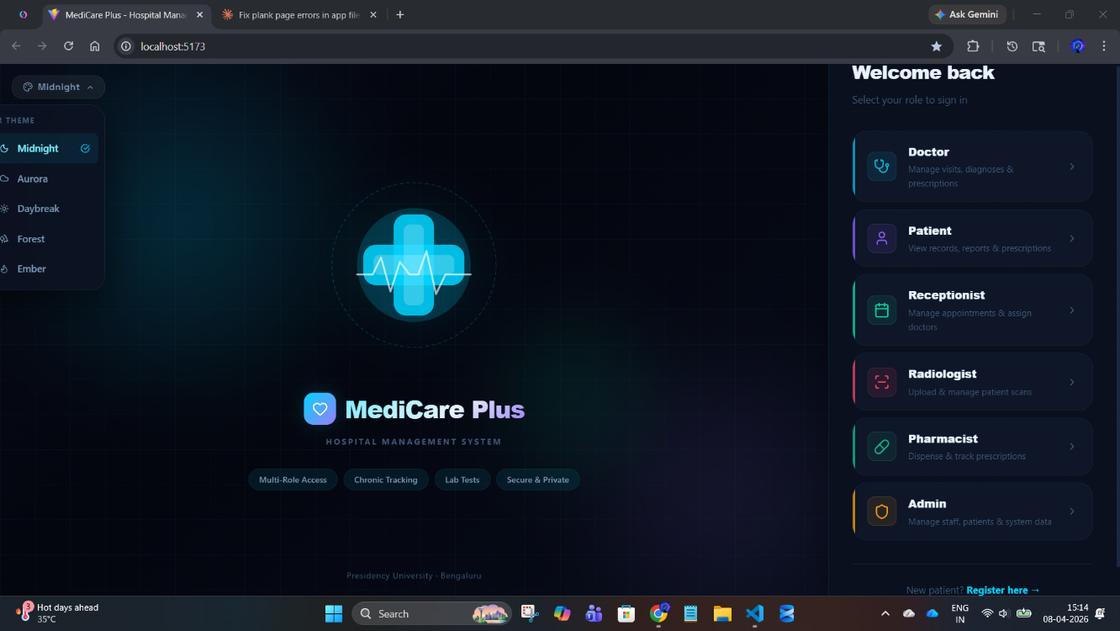
Output
Screenshot Placeholders
Fig A.1: MediCare Plus Landing Page
This image shows the MediCare Plus landing page with a dark-themed interface and role-based login options for secure system access.

Slide 19
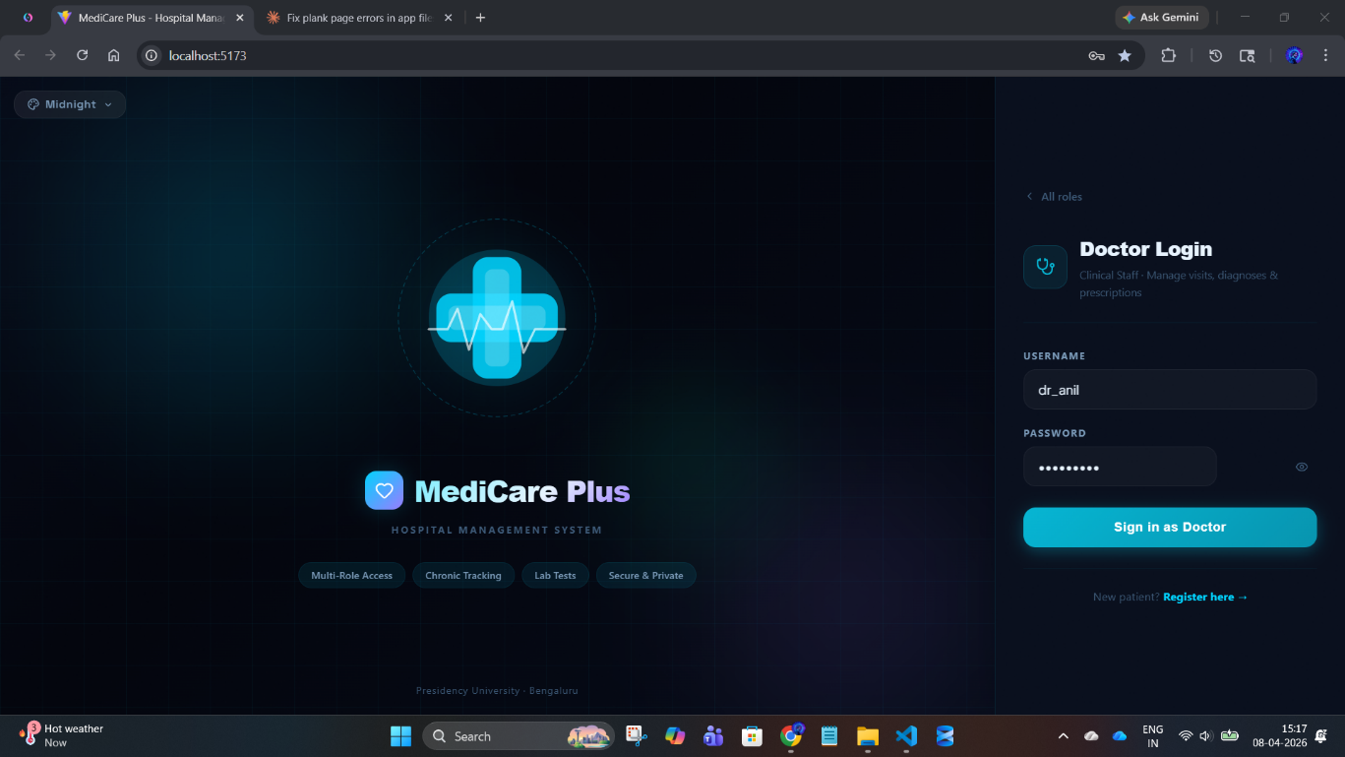
Fig A.2: Doctor Login Interface
This image shows the Doctor Login screen of MediCare Plus enabling secure access for managing visits, diagnoses, and prescriptions.

Slide 20
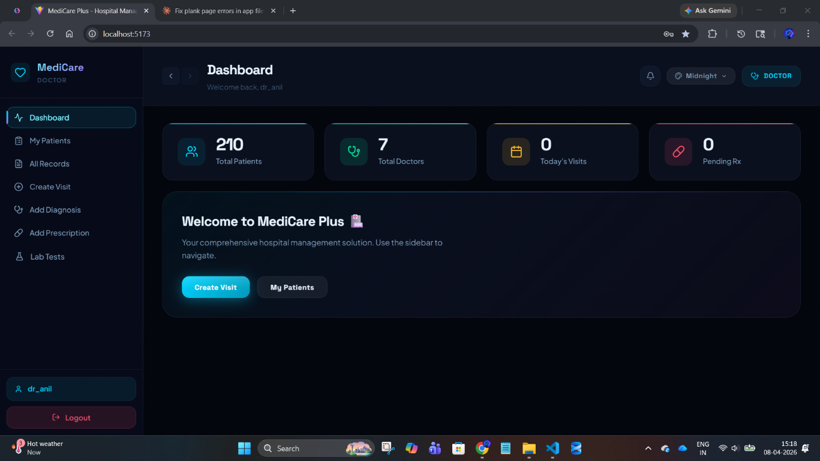
DOCTOR DASHBOARD:
Figure A3: Doctor Dashboard Interface
This image shows the Doctor Dashboard of MediCare Plus displaying patient statistics, navigation options, and quick actions for managing visits and records.

Slide 21
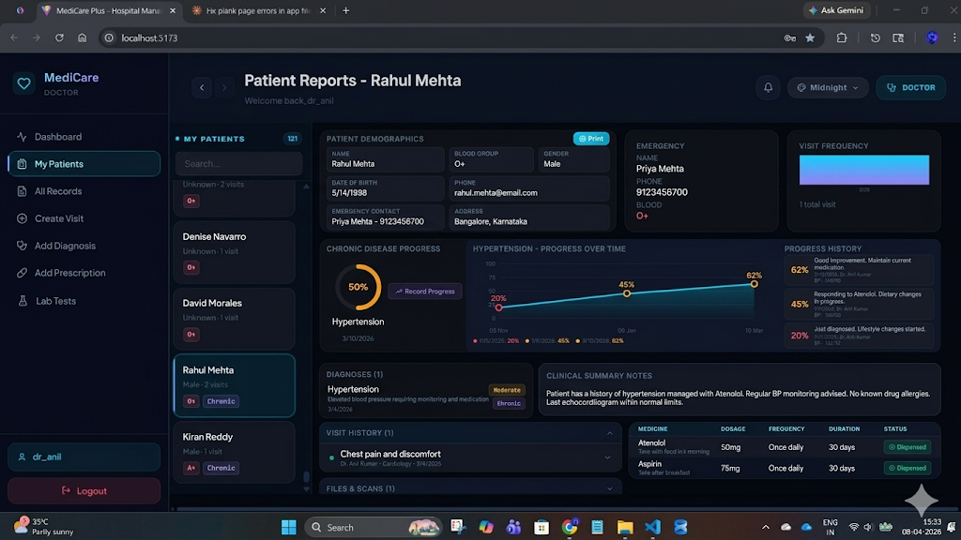
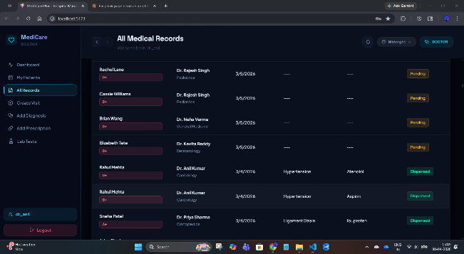
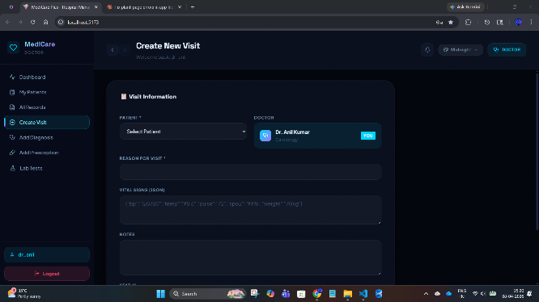
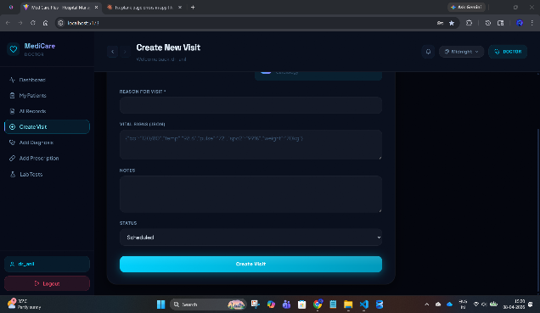
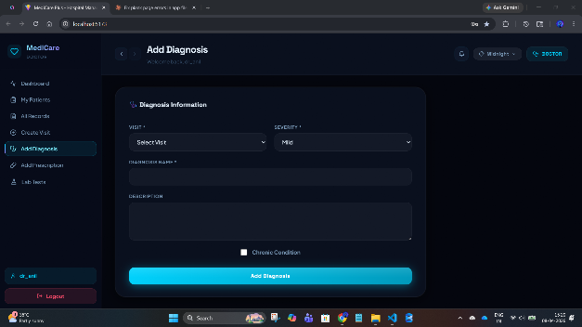
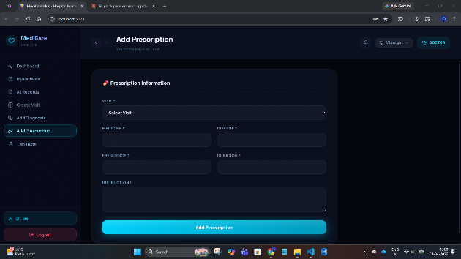
Fig A.4: My Patient Reports Interface
Fig A.5: All Medical Records Interface
Fig A.6: Create New Visit Interface
Fig A.8: Add Prescription Interface
Fig A.7: Add Diagnosis Interface
Fig A.6.1: Create New Visit Interface

Slide 22
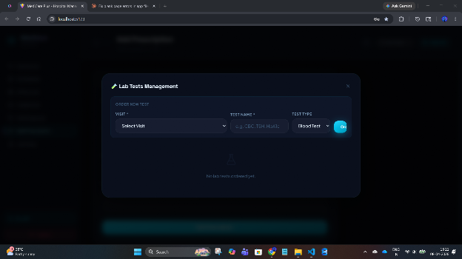
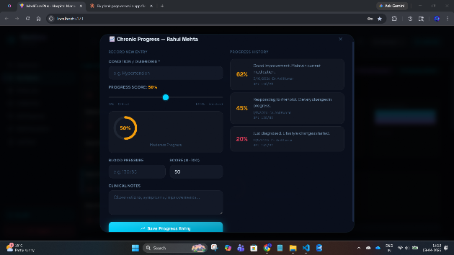
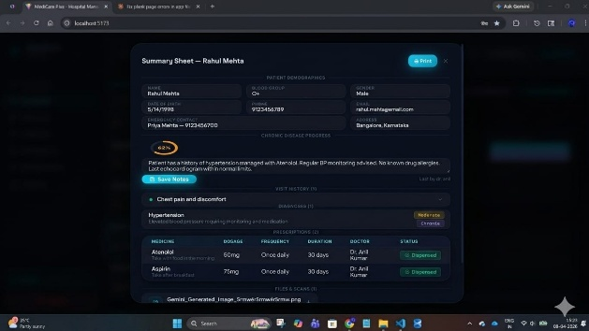
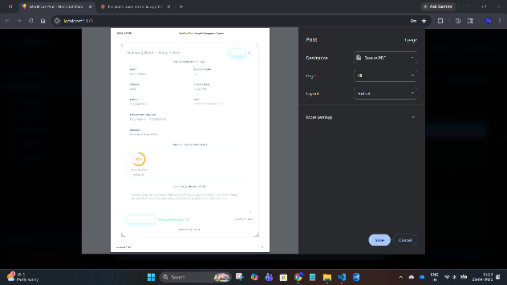
Fig A.9: Lab Tests Order Interface
Fig A.10: Chronic Disease Progress Tracking Interface
Fig A.12: Report Export Interface
Fig A.11: Patient Summary Sheet Interface

Slide 23
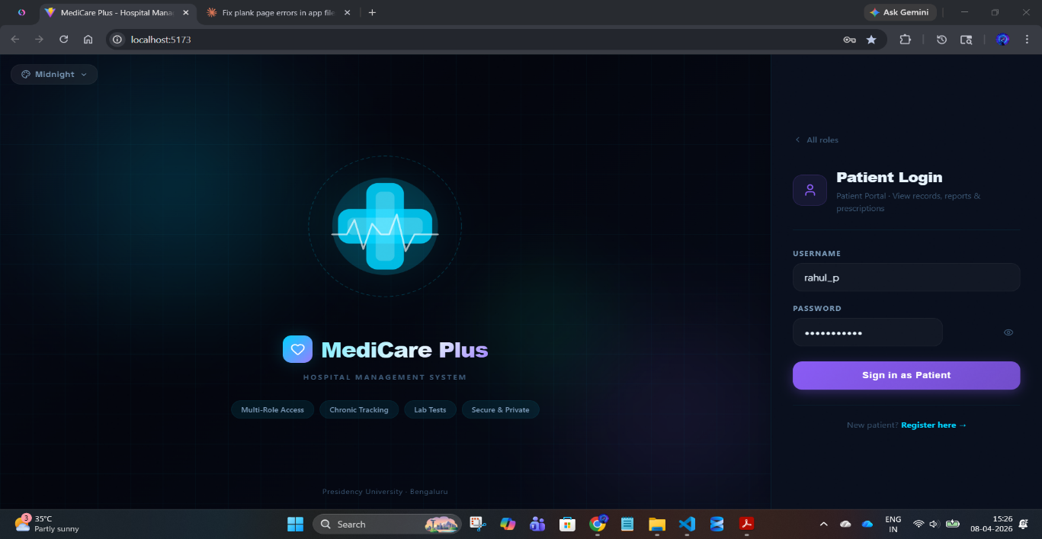
Fig A.13: Patient Login Interface
This image shows the Patient Login screen of MediCare Plus allowing patients to securely access their records, reports, and prescriptions.

Slide 24
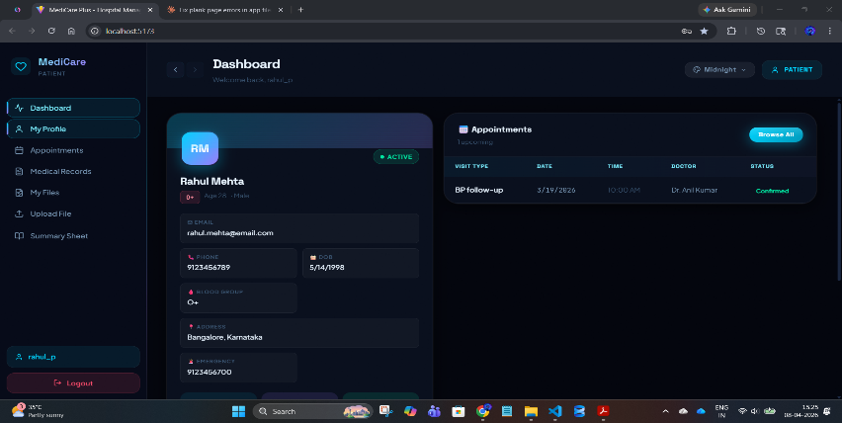
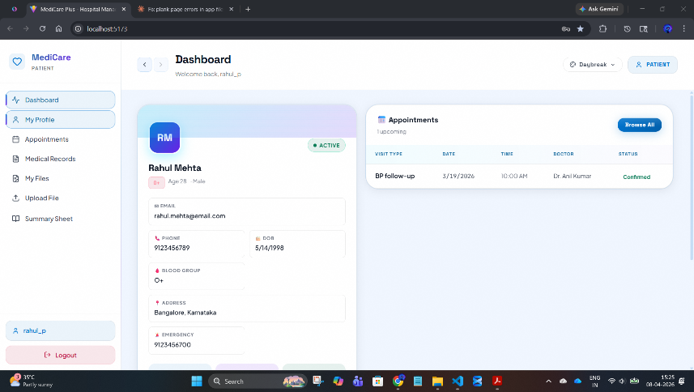
PATIENT DASHBOARD:
Dark Theme
Light Theme
Fig A.14: Patient Dashboard Interface
This image shows the Patient Dashboard of MediCare Plus displaying personal details, medical information, and upcoming appointment status.

Slide 25
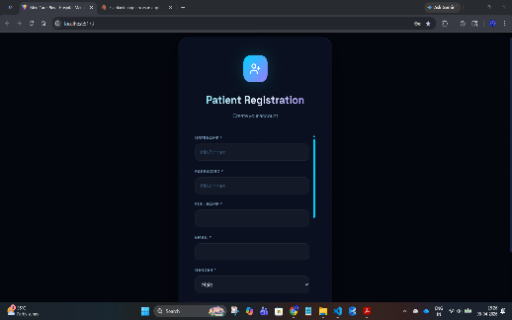
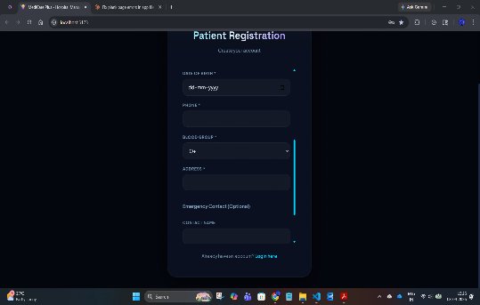
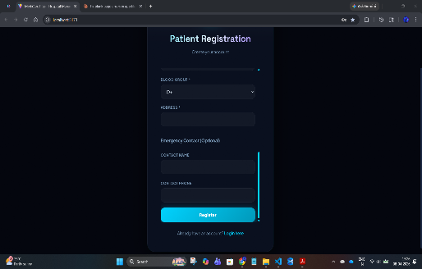
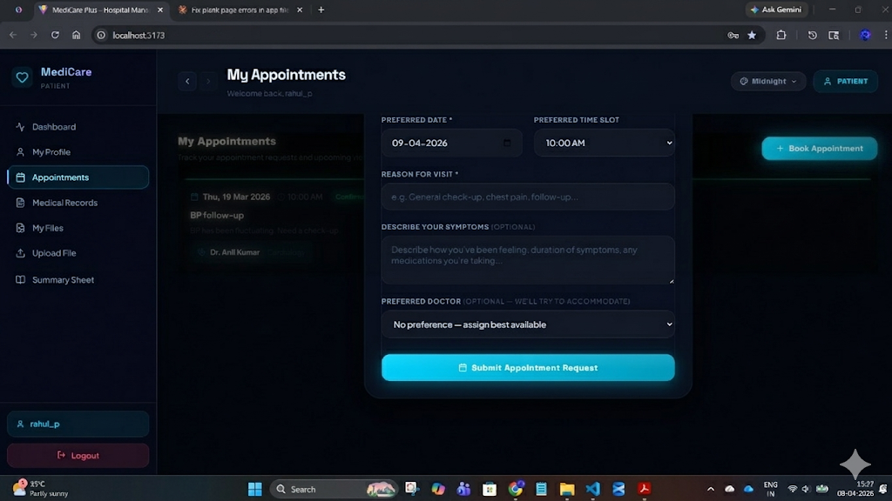
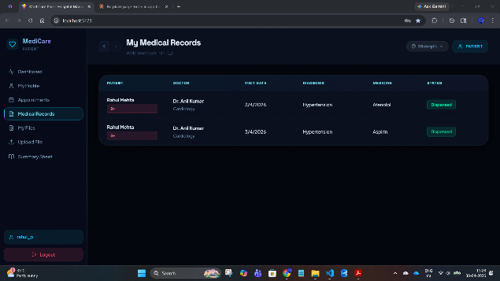
Fig A.15: Patient Registration Interface
This image shows the Patient Registration screen of MediCare Plus where new users enter personal and login details to create an account.
Fig A.17: Patient Medical Records Interface
Fig A.16: Appointment Booking Interface

Slide 26
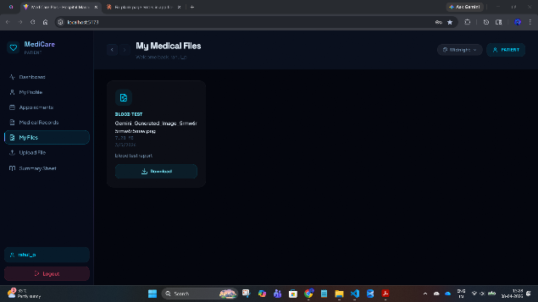
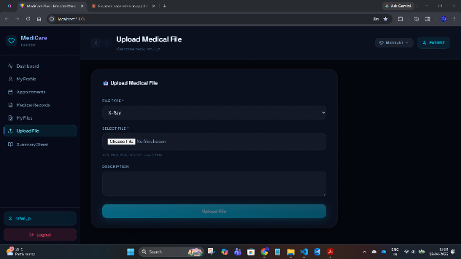
Fig A.18: Medical Files Interface
Fig A.19: Upload Medical File Interface

Slide 27
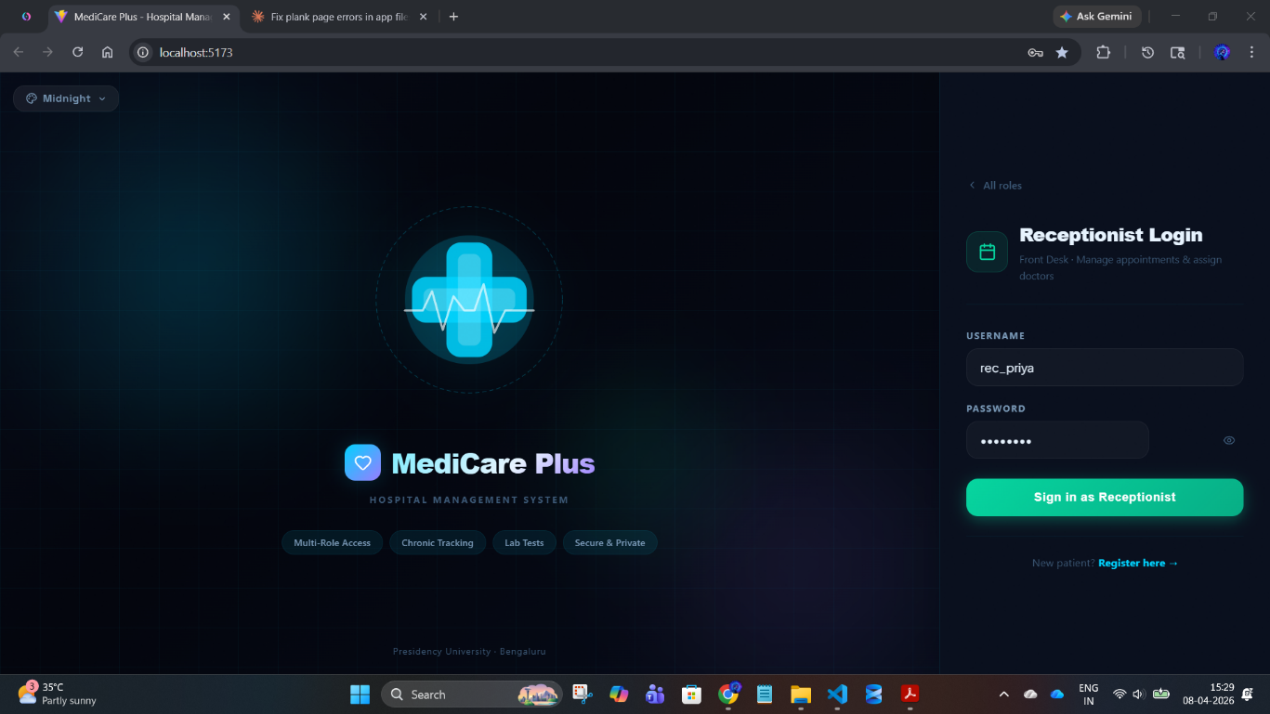
Fig A.20: Receptionist Login Interface
This image shows the Receptionist Login screen of MediCare Plus enabling staff to manage appointments and assign doctors securely.

Slide 28
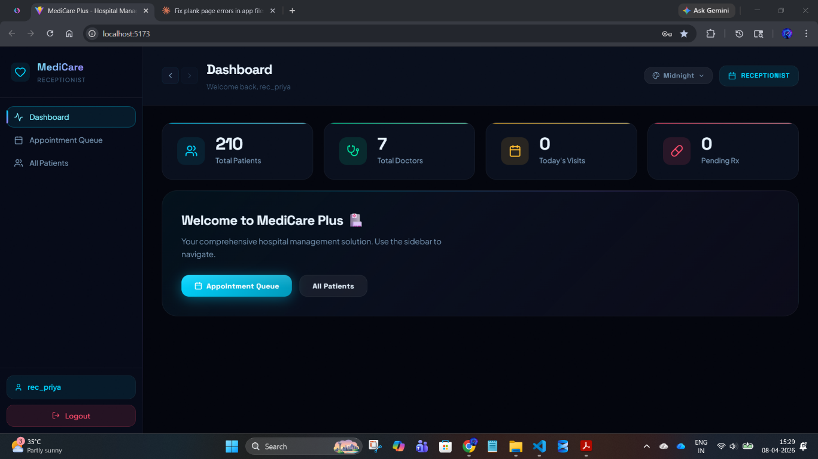
RECEPTIONIST DASHBOARD:
Figure A21: Receptionist Dashboard Interface
This image shows the Receptionist Dashboard of MediCare Plus displaying patient statistics and options to manage appointment queues and patient records.

Slide 29
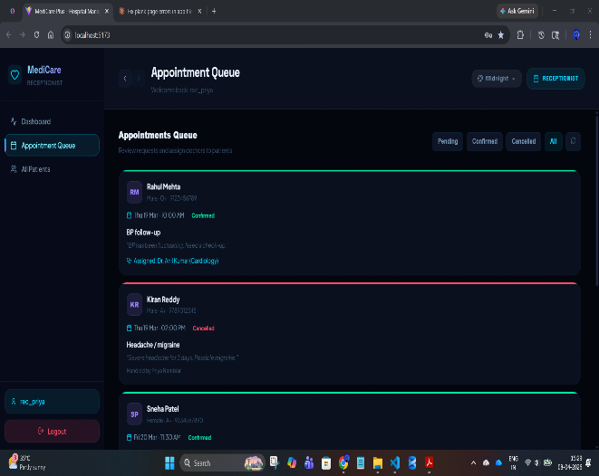
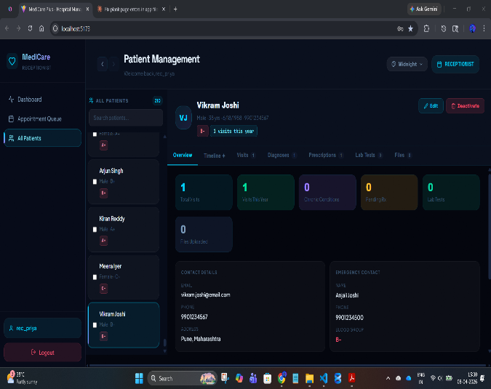
Fig A.22: Appointment Queue Interface
This image shows the Appointment Queue of
MediCare Plus where the receptionist reviews
, manages, and assigns patient appointments.
Fig A.23: Patient Management Interface
This image shows the Patient Management screen
of MediCare Plus displaying patient details, visit statistics,
and record overview.

Slide 30
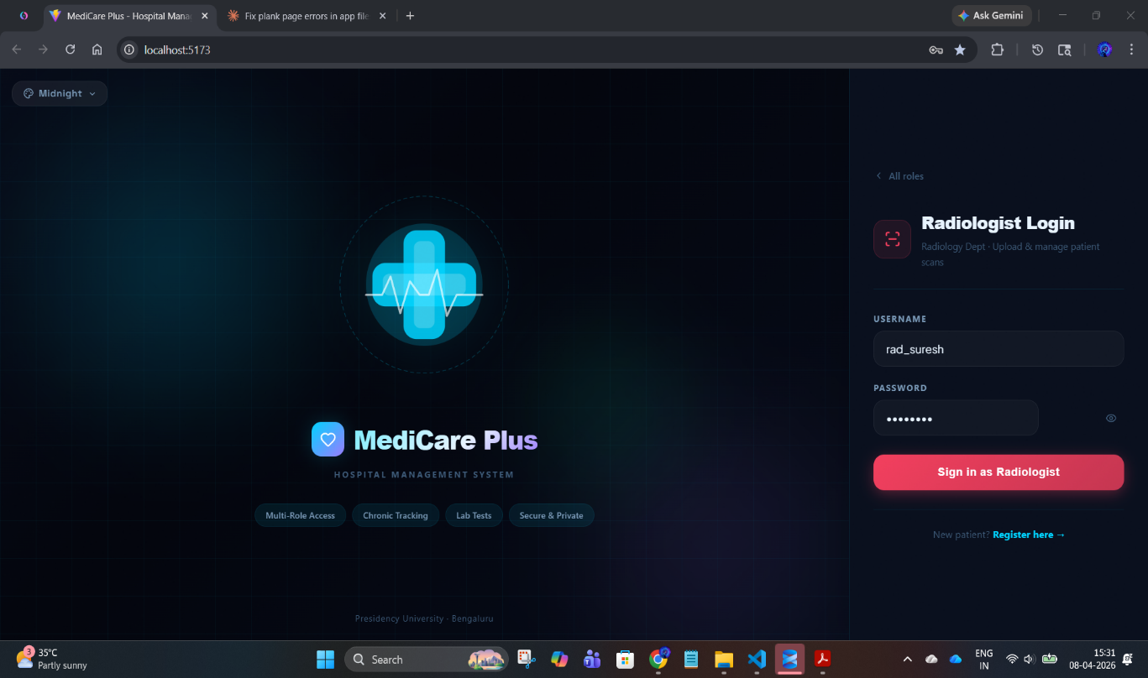
Fig A.24: Radiologist Login Interface
This image shows the Radiologist Login screen of MediCare Plus enabling secure access to upload and manage patient scan reports.

Slide 31
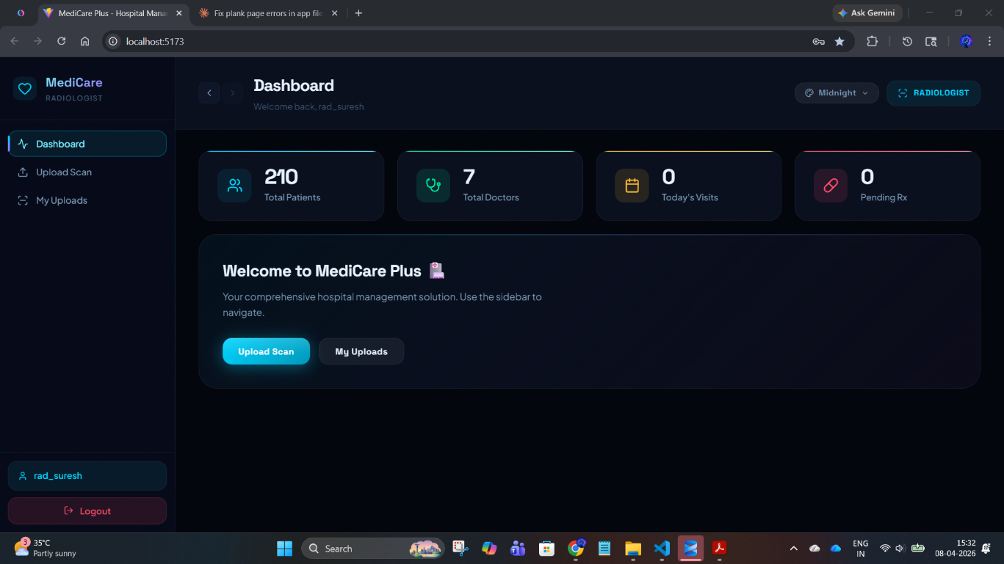
RADIOLOGIST DASHBOARD:
Fig A.25: Radiologist Dashboard Interface
This image shows the Radiologist Dashboard of MediCare Plus displaying system statistics and options to upload and manage diagnostic scans.

Slide 32
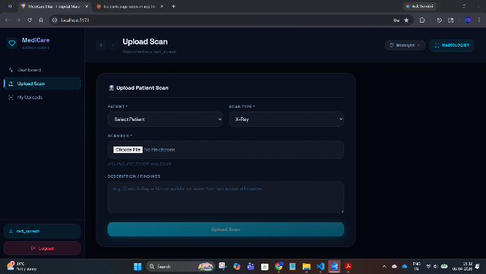
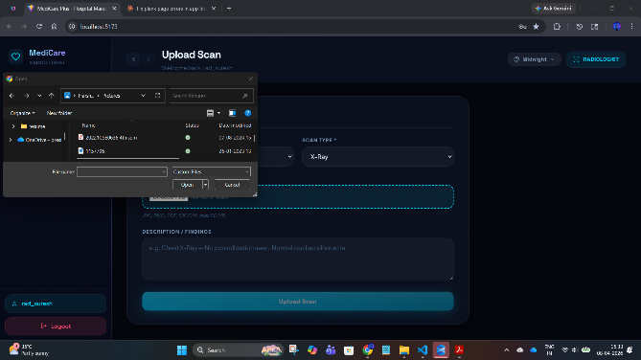
Fig A.26: Upload Scan Interface
This image shows the Upload Scan screen of
MediCare Plus where radiologists select patients,
upload scan files, and add diagnostic findings.
Fig A.27: Scan File Selection Interface
This image shows the file selection dialog used
by radiologists to choose and upload scan files
from the system.

Slide 33
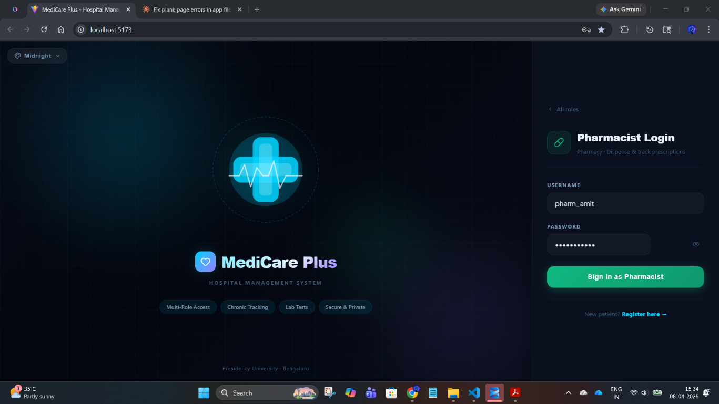
Fig A.28: Pharmacist Login Interface
This image shows the Pharmacist Login screen of MediCare Plus enabling secure access to manage and dispense prescriptions.

Slide 34
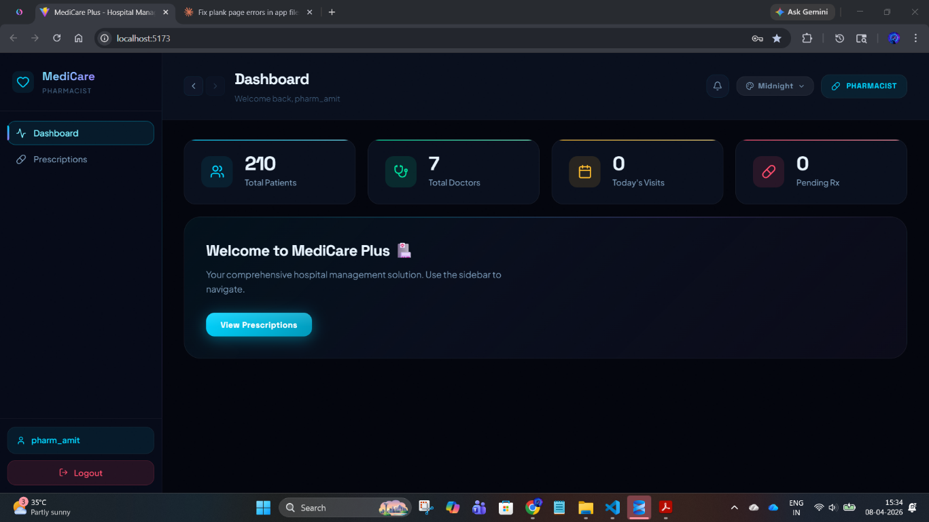
PHARMACIST DASHBOARD:
Fig A.29: Pharmacist Dashboard Interface
This image shows the Pharmacist Dashboard of MediCare Plus displaying system statistics and options to view and manage prescriptions.

Slide 35
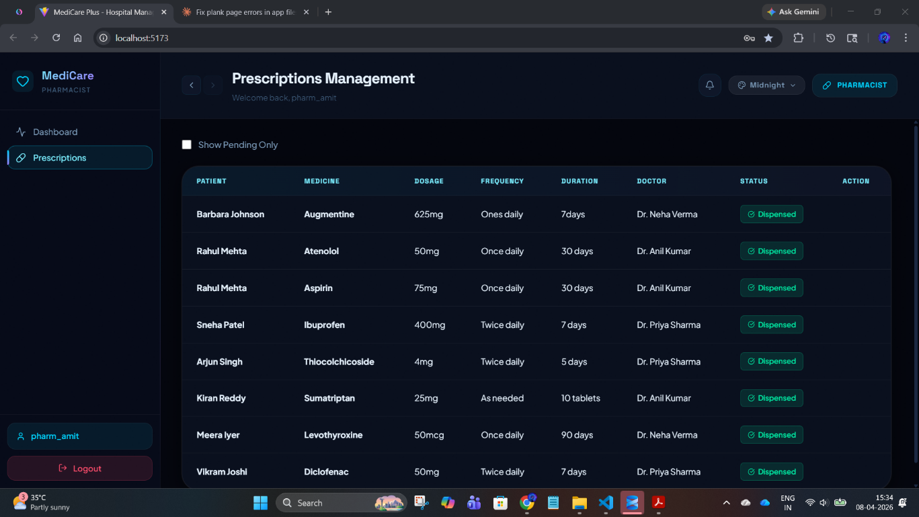
Fig A.30: Prescriptions Management Interface
This image shows the Pharmacist’s Prescriptions Management screen displaying patient prescriptions with details
such as medicine, dosage, frequency, duration, and dispensing status

Slide 36
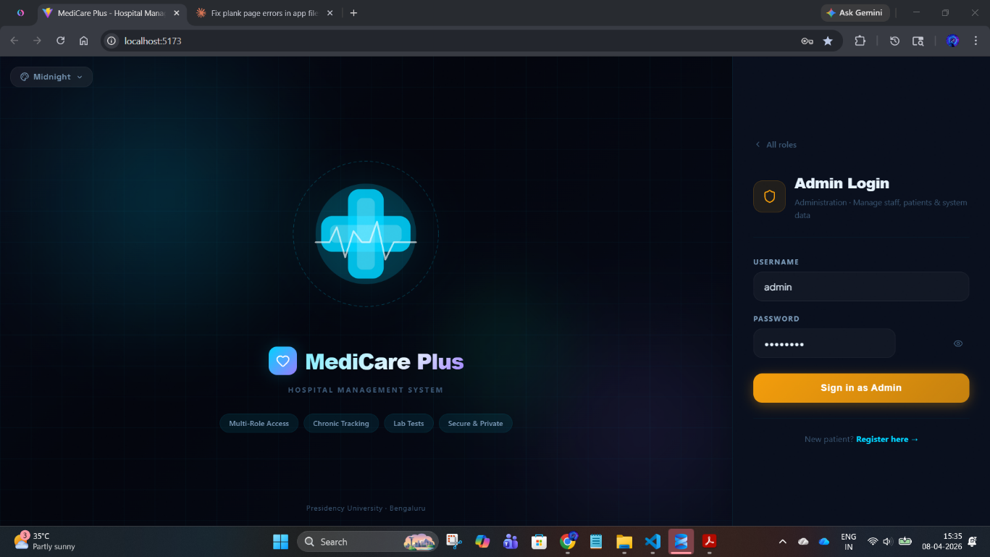
Fig A.31: Admin Login Interface
This image shows the Admin login screen of MediCare Plus with fields for username and password to access system administration features.

Slide 37
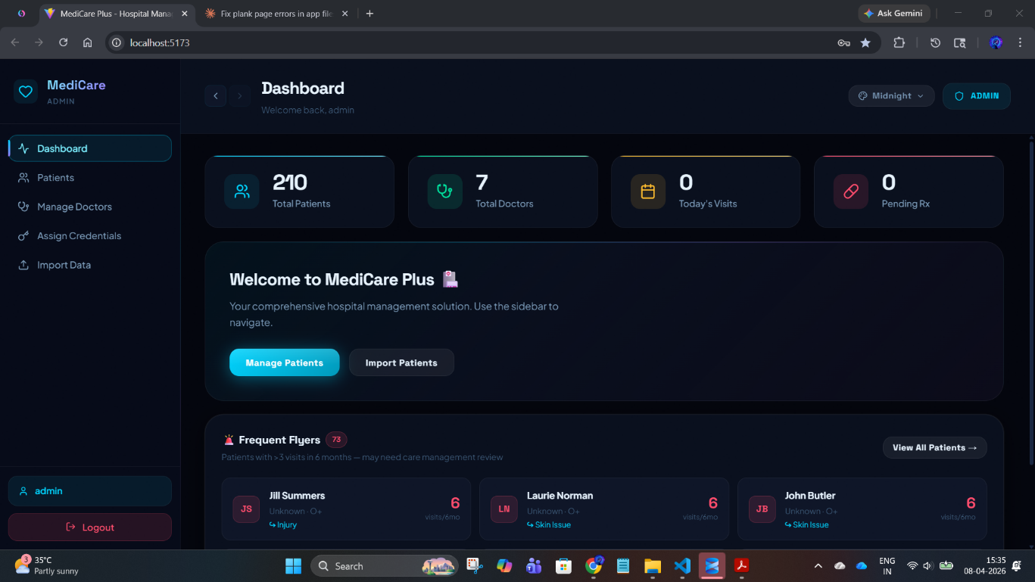
ADMIN DASHBOARD:
Fig A.32: Admin Dashboard Interface
This image shows the Admin dashboard displaying key metrics like total patients, doctors, visits, and options to manage and import patient data.

Slide 38
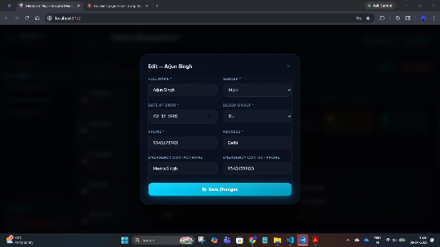
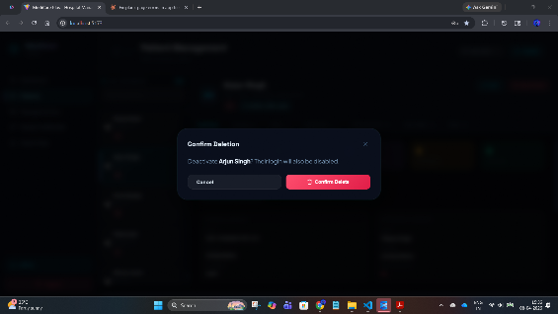
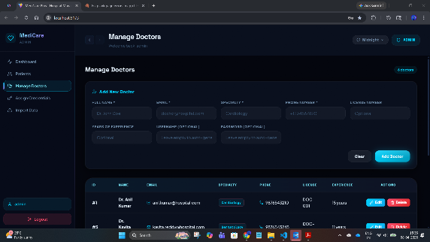
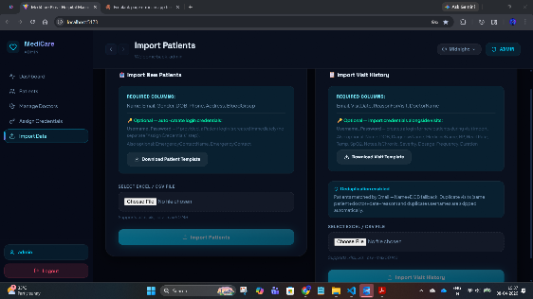
Fig A.34: Delete Confirmation Dialog
Fig A.33: Edit Patient Details Interface
Fig A.35: Manage Doctors Interface
Fig A.36: Import Patients and Visit Data Interface

Slide 39
Github Link
https://github.com/meharshithv14-ctrl/INTERNSHIP

Slide 40
Q&A

Slide 41
Thank you !!

